Slide 1


• FOR PARENTS •
— AI-Powered Tutor —
Your child’s personal math tutor
✓ Complete visibility into your child’s learning.
✓ Complete control over your family's data.
mrcadabra.com
Notes:
You want a great math tutor for your child — and complete visibility and control for yourself. Mr. Cadabra gives you both.

Slide 2

What matters most to parents
⭐ Your parent view
A clear view of progress and where to help next.
⭐ Your child's learning
A patient tutor that teaches, not just answers.
⭐ Your family's privacy
Complete control of your family's data.
Notes:
Three things matter: your child's learning, what you get to see, and your family's privacy.

Slide 3
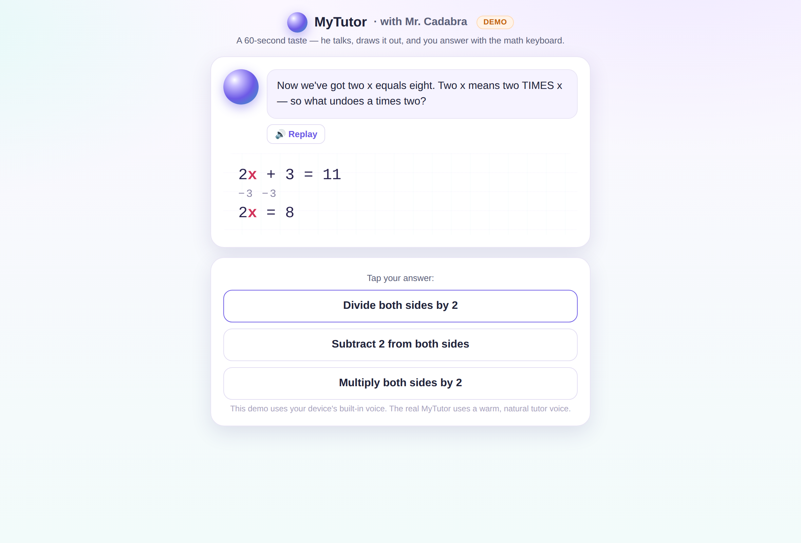
A tutor that teaches — never just answers
Mr.Cadabra explains out loud, draws every step, listens to your child's answer, and asks the next question instead of giving the answer.
He's math-only and won't be talked off topic — even when kids try.
Notes:
Mr. Cadabra teaches — he never just answers. He explains out loud, listens to your child, and can't be talked off math.

Slide 4
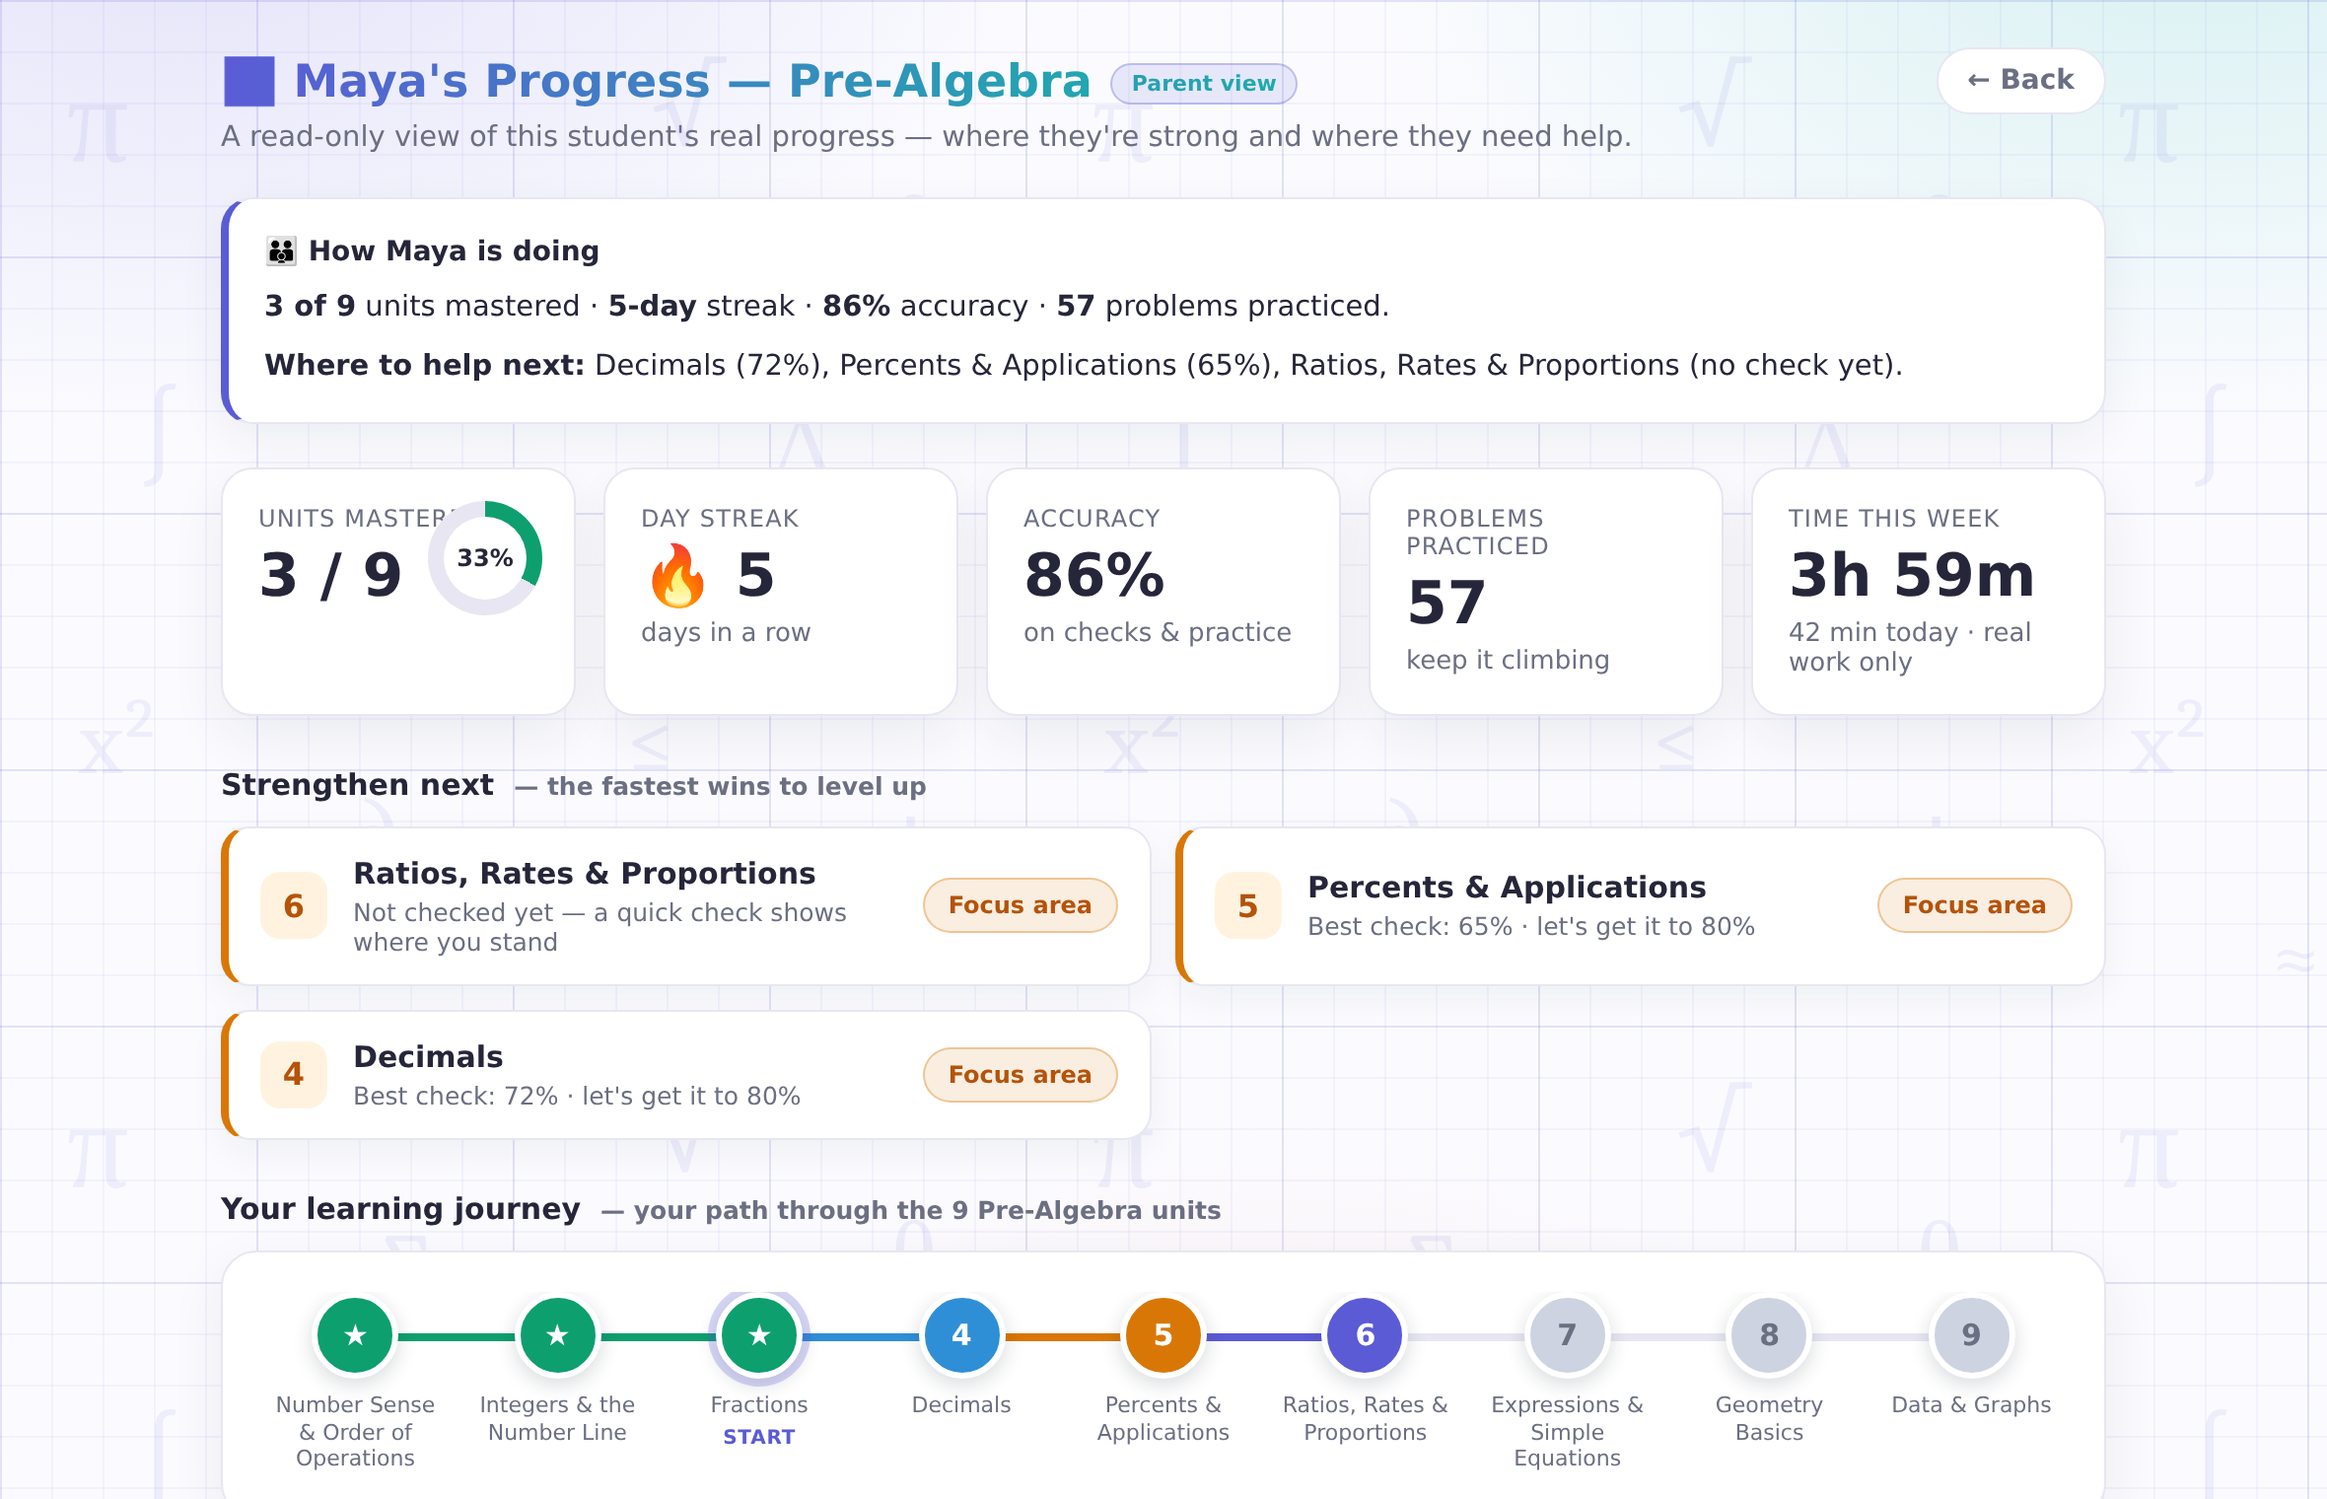
See what matters
Your free parent account opens a read-only dashboard with your child's progress, where help is needed next, and real scores from real checks.
Notes:
Your free parent account opens a read-only view: real progress, real scores, and where to help next.

Slide 5
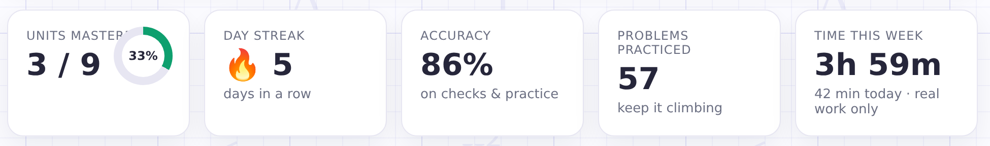
Honest time, honest numbers
A minute counts only when your child is actually working — walk away or switch tabs and the clock stops.
"42 minutes today" means 42 minutes of math.
Notes:
Time is honest, too. The clock runs only while your child is actually working — and a weekly email keeps you posted.

Slide 6




Privacy promises we can keep
No voice recording kept
Never sold, no ads
You hold the keys
Voice recordings are discarded after each task is evaluated.
We never sell student data. Children are never asked for an email, phone number, photos, or location.
You control the account—and if you ever want your child's data deleted, just let us know.
Notes:
Voice audio is deleted immediately. Student data is never sold, and there are no ads. You hold the keys.

Slide 7
See Mr.Cadabra in action.
— AI-Powered Tutor —
Try one short lesson yourself — answer out loud — and see if it's right for your family.
mrcadabra.com/demo
Notes:
Judge him yourself. Try one short lesson — out loud — at mrcadabra.com/demo.

